Slide 1

WELCOME 4th GBM
Pre-Law Jeopardy

Slide 2
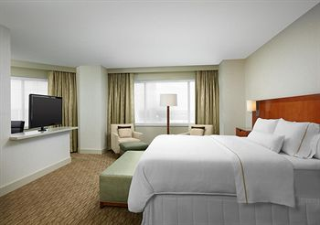
9th Annual National Black Pre-Law Conference
Admission
Hotel
General Admission is FREE
Register for the conference this week!!!
More information can be found on our website: http://prelawnblsa.wix.com/ut-prelawnblsa
Hotel: $125; $93.75/ night
  *IF have 4 people in your room

Slide 3

Membership Dues Package
Longhorn Chapter
National Chapter
Makes you Pre-Law member
Eligible for LSAT scholarship
Free membership T- shirts
Eligible for Stipends
Eligible for Membership of the Month Awards
Total : $35
Makes you national member
Eligible for LSAT scholarship
Free membership T-shirts
Eligible for Nelson Mandela scholarship
Discount on Regional & National Conference
Eligible for Membership of the Month Awards
Eligible for Stipends
Total: $45

Slide 4
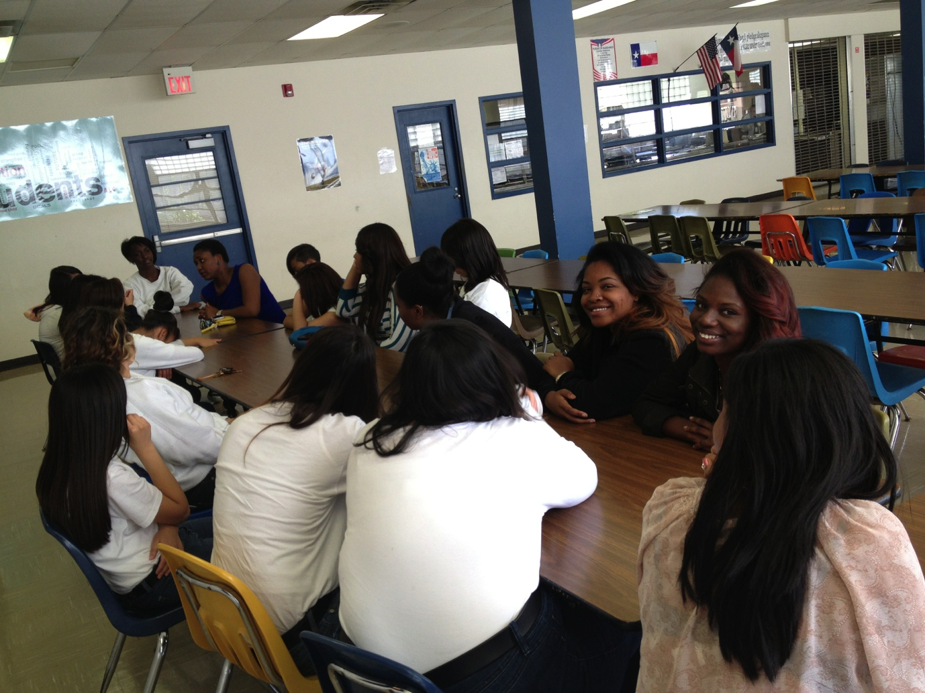
ASHAKI Mentoring
Mentoring starts this FRIDAY.
  1-3pm
  If you need transportation, please let us know

Slide 5

Community Service Week: Trick,Treat, Serve.
Trick or Treat for Unicef
Austin Food Bank
Lady Bird Lake Clean Up
Casa de Marinella
  In order to volunteer at casa de marinella you have to attend a training session
  ASHAKI

Slide 6

Annual Austin AIDS WALK
Date: Sunday October 20th
Location: Republic Square Park
Time: 9am

Slide 7
Upcoming Socials:
October 25th – Jason Deli’s Pre-law Social/ Fundraiser
October 31st – Trick or Treating

Slide 8

^{5th} GBM
Special Guest: Honorable Judge Eric M. Shepperd

